Slide 1
Adaptive Card Extensions Design Sample Gallery
Derek Cash-Peterson (he/him)

Slide 2








Derek Cash-Peterson Principal Architect
20+ Years Experience with SharePoint Microsoft MVP/PnP Team Member Specialist in UX Design/Branding and Development MSFT Learning Pathways Co-Maintainer SPFx ACEs Sample Repo Co-Maintainer
spdcp.com
linkedin.com/in/dcashpeterson
@spdcp

Slide 3
Goals
Provide examples for showing more visually appealing designs in the quick view
Provide a demo ready art of the possible to showcase Viva Connections
Provide an example of using built in functions to manipulate data.
Provide an example of localization
Provide an example of how-to deep link from an ACE into Teams
Source of questions: Inspired: How the Best Companies Create Technology-Powered Products and Services, by Marty Cagan, Wiley, 2018, pp. 55.

Slide 4
Solution Components
12 Adaptive Card Extension examples in one solution
Personal app to serve as a gallery in Teams to showcase and education about Adaptive Card Extensions and surface deep links
Free app in Microsoft Store for no fuss installation in your tenant
Source code available for you to use
Source of questions: Inspired: How the Best Companies Create Technology-Powered Products and Services, by Marty Cagan, Wiley, 2018, pp. 55.

Slide 5
Demo

Slide 6
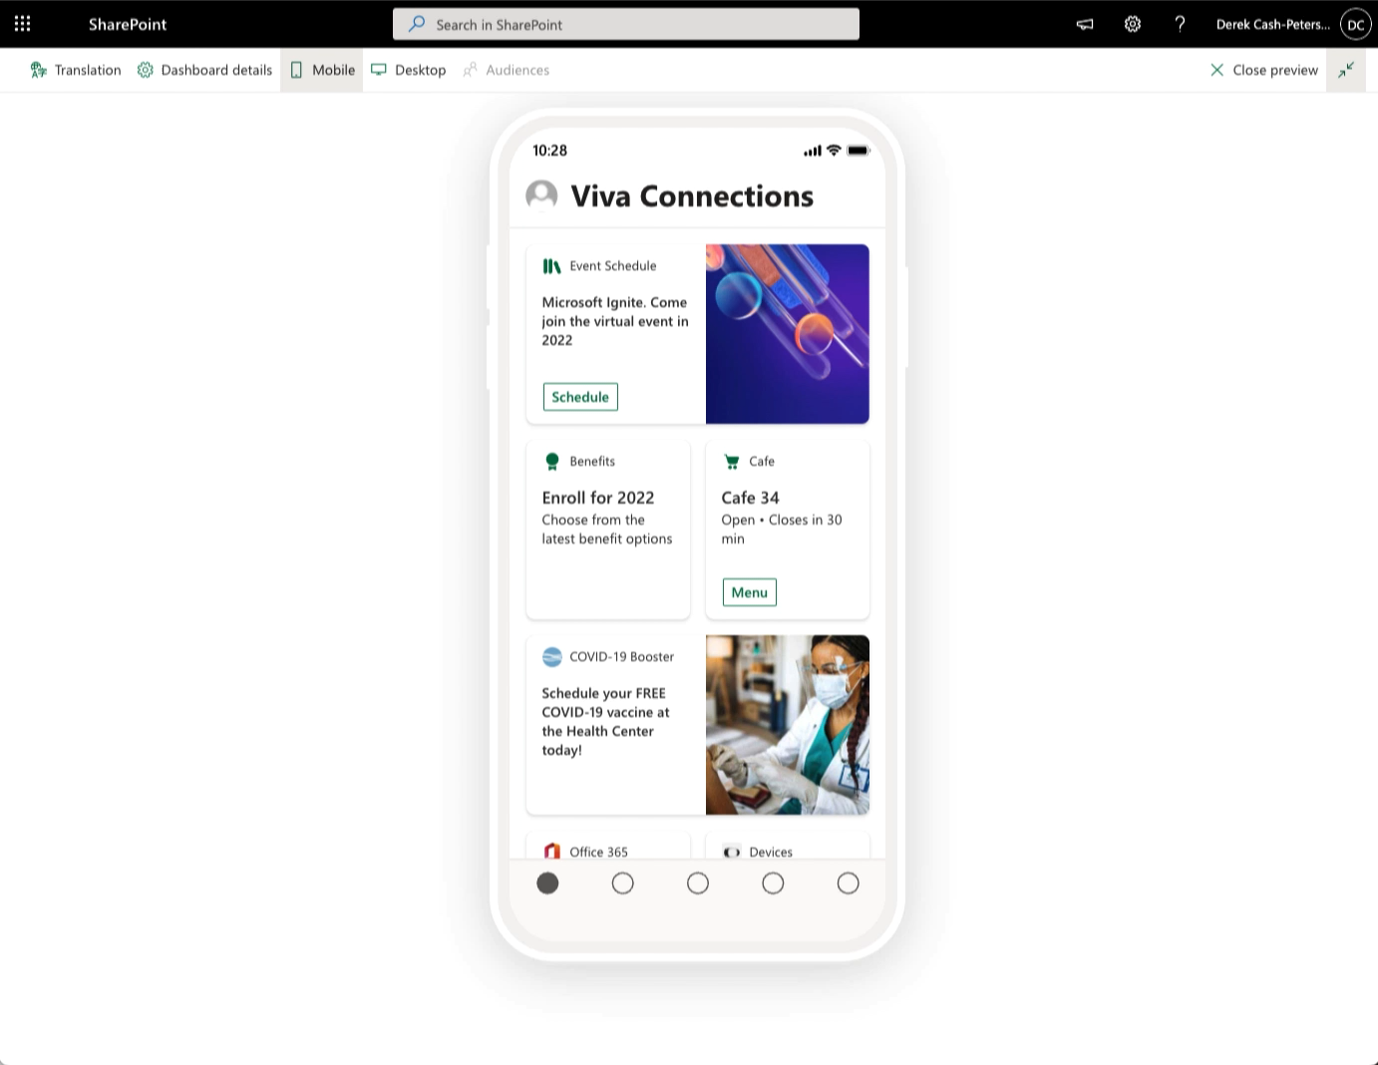

Slide 7
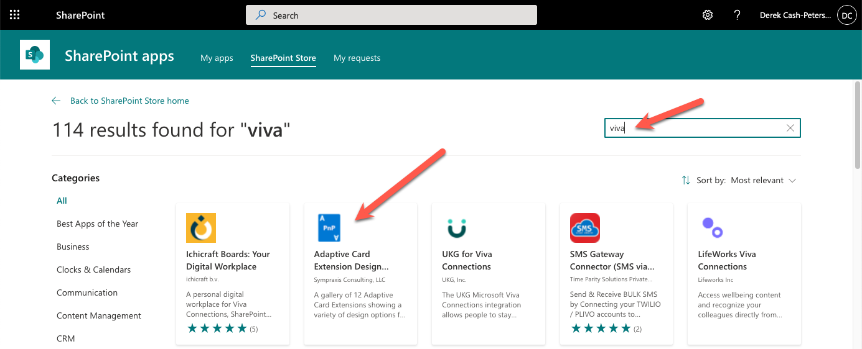
Resources
Source Code: https://symp.info/ACEDesignGallery
App Store: From App Catalog > SharePoint Store > Search Viva

